Slide 1




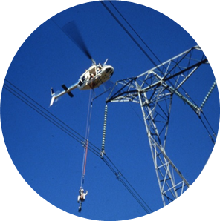
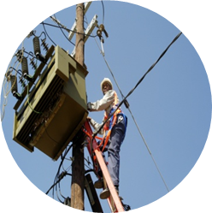
PDE EiT Assessment (18 month review)
Presented by: Kavish Mathuradas
Unique Number: 431473
Date: 19/10/2018
Mentor: Thavenesen Govender
Chief mentor: Sidwell Mtetwa
Studied: University of Kwa-Zulu Natal
Qualification: BSc Electrical Engineering

Slide 2
Content
Eskom’s life saving rules
Training completed
System Operator
PTM&C: Protection Technology
On going tasks
General remarks

Slide 3

Eskom life saving rules
Rules
Rule 1 | Open, Isolate, test, earth, bond, and/or insulate before touch
Rule 2 | Hook up at heights
Rule 3 | Buckle up
Rule 4 | Be sober
Rule 5 | Ensure that you have a permit to work

Slide 4
Training
Power Delivery Engineering (PDE)
Core and Field exposure
Core exposure
Distribution Field Services & Operations
First 12 months
System Operator
Elective period –
PTM&C: Protection Technology
6 weeks
12 weeks
12 month
review
18 month
review

Slide 5
System Operator
Controlling the operation of and be responsible for the short term reliability of Eskom’s power system
Key responsibilities:
National Control Centre must operate the power system and ensure the delivery of power to Eskom customers at all times, with the support of Technical Operations
Ensuring security and quality of supply by:
Limiting the impact of major incidents on the system network
Reducing operating error

Slide 6
System Operator hierarchy
System Operator
Technical Operations
Operations Planning
Operations Performance
National Control System Support
Ancillary Services
Network Appraisals
Metering and Data Services
Business Support Services

Slide 7
Network Appraisals – Outage studies
Grids
Grids
Grids
Grids
Grids
Outage Scheduling Department
Operations Planning department
Information is then relayed to the necessary stakeholders

Slide 8
Hera-Midas 400 kV line outage 19th July
5 minute snapshot taken at 08:40 for 7th June 2018
Simulate using PSS/E

Slide 9
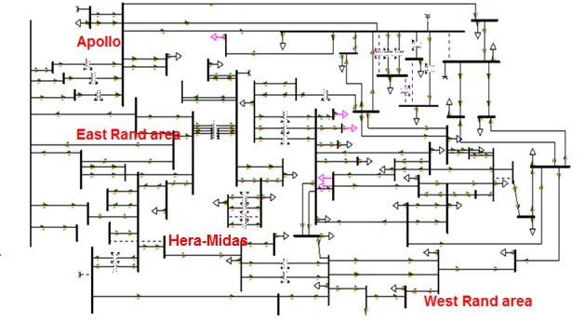
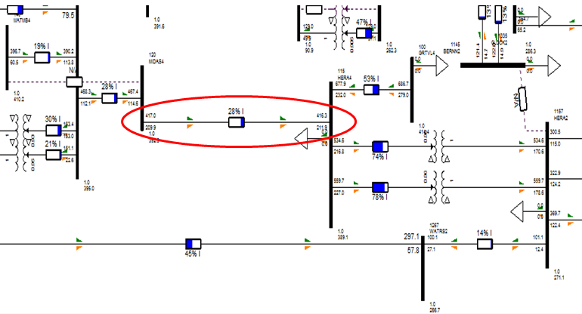
Modifying the casefile

Slide 10
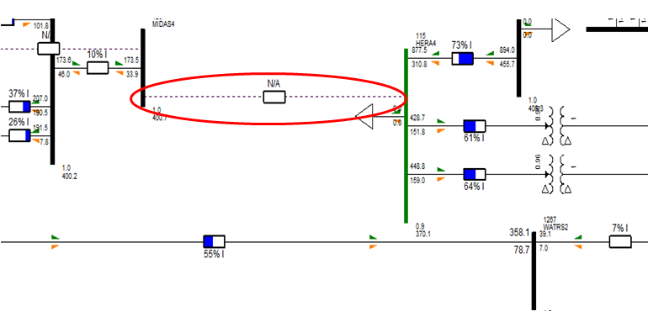
Simulating the outage

Slide 11
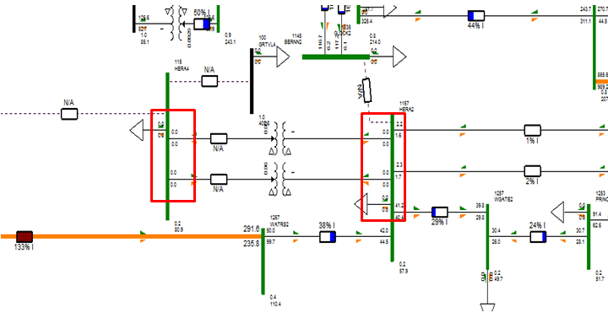
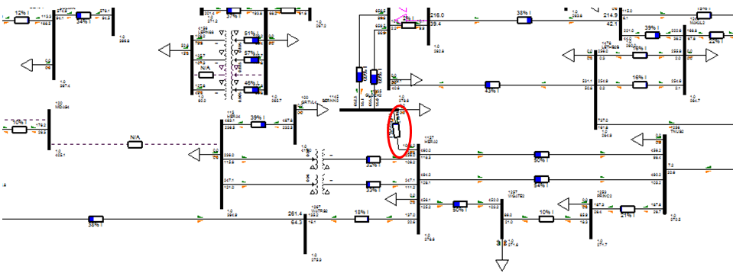
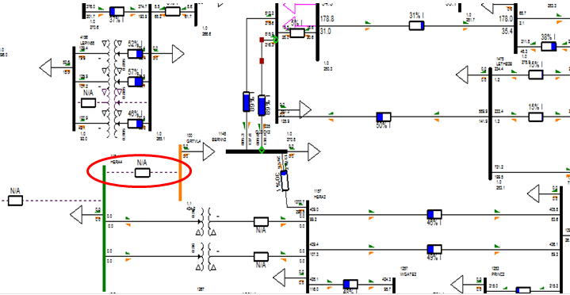
Contingency analysis

Slide 12
Lessons learnt
Better understanding of power flows
Planned outages must be done at an opportune time to ensure the safety of personnel – should not overload equipment or cause imbalances in the network (system must be N-1 compliant during outage)
Results were similar to those performed by Network Appraisals engineer

Slide 13
Protection Technology
One of the legs of PTM&C
Provides specialist engineering support for the life cycle management and development of protection technology within Eskom Transmission and Distribution divisions
PTM&C
Control & Automation Substation Technologies
Control Applications
Protection Technology
Telecommunications Technology
Project Engineering and Support
DC and Metering

Slide 14






Busbar protection philosophy
Buszone
Differential protection
$$I_{1}$$
$$I_{2}$$
$$I_{3}$$
B/B
$$I_{4}$$
$$I_{5}$$
$I_{1}\text{∠}0+I_{2}\text{∠}0+I_{3}\text{∠}0+I_{4}\text{∠}0+I_{5}$∠180 $≅$0
Standards used:
240-56364481: Protection Settings Philosophy for EHV and HV Networks
DST 34-461: Distribution standard for the application of bus zone protection
TST41-959: Buszone Protection Philosohpy

Slide 15
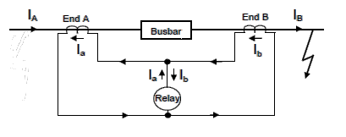
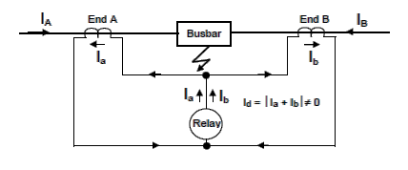
Current differential protection – Through-faults and in zone faults
Busbar protection within Eskom consists of two different applications:
High Impedance busbar protection, and
Low impedance busbar protection
*Diagrams used from 240-56364481: Protection Settings Philosophy for EHV and HV Networks

Slide 16
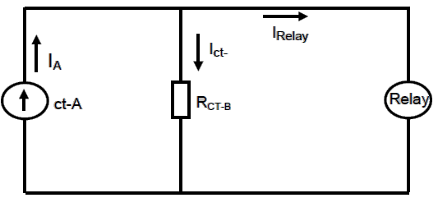


Equivalent circuit for through-fault conditions with CT saturation
R_{STAB}
$$I_{A}=I_{fault}/CTR$$
$$I_{fault}−Maximum fault current$$
$I_{CT−B}−Component of I_{A} flowing through R_{CT} of the saturated CT−B$
$I_{Relay}−Component of I_{A} flowing in the relay$

Slide 17
Feeder protection scheme refurbishment
Timeline
Phase I
Phase II
Phase III
Phase IV
Phase V
1960s – 1980s
1980s – 1992
1990s –2000s
1990s –2000s
2002
Phase I
40 – 60 years
Phase II
30 – 40 years
Phase III
10 – 15 years
Phase IV/V
10 – 15 years

Slide 18
Requirements
Protection Technology, has decided to execute replacement strategies for 3 feeder protection schemes over an 18 month period. These most urgent being:
Phase III
Phase II (TLS)
Phase IV/V
Task
Develop and write the Stakeholder Requirements and Alternative Design documents
Stakeholder requirements definition – Aging protection scheme life extension (document 240-141856326 awaiting signatures)

Slide 19
Design process
Systems Analysis Phase
Systems Design Phase
Systems Evaluation Phase
Systems Synthesis Phase
Systems Commissioning Phase
Stakeholder requirements definition – Aging protection scheme life extension (document 240-141856326 awaiting signatures)

Slide 20
Phase III proposed solution
There are presently 117 modular and 12 non-modular Phase III schemes within Transmission grids
Modular schemes
Short-term
Siemans 7SA513 | Primary protection
Siemans 7SV512 | Breaker failure
Siemans 7VK512 | Auto reclose
Short term (Solutions)
REL670 (ABB) | Primary protection
7VK61 (Siemans) | Breaker failure
7VK61 (Siemans) | Auto reclose
Non-modular schemes
Replace 7SA513 with REL670 retrofit and 7SV, 7VK with 7VK61 to free up 7SA513, 7SV512 and 7VK512 modular relays respectively (7SA, 7SV and 7VK relays can fit into modular and non-modular schemes)
Long-term strategy
Develop Main 1 and Main 2 retrofits to replace the functions of the 7SA513, 7SV512, and 7VK512 relays upon failure

Slide 21
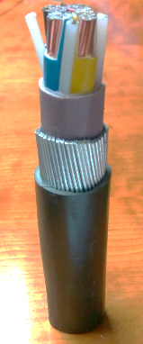
Copper Clad Aluminium Alloy (CCAA) cable specification
Trigger: Theft of Copper cables is a pressing problem
Control signal cables – traffic light cables
Develop Copper Clad Aluminium Alloy (CCAA) cables spec – Consists of an Aluminium core thoroughly bonded to outer layer of copper
Possible method of deterring cable theft, does not have a high scrap value
Eskom WG and NRS 110 WG

Slide 22
CCAA cables specification (contd…)
Task: Develop the specifications and present at WG meetings
Merge documents presented at NRS WG (Eskom and Aberdare cables specs)
Final Eskom WG (04/07/2018) and NRS WG (14/08/2018)
Standards used:
SANS 1411-1 Materials of insulated electric cables and flexible cords: Part 1 Conductors
SANS 1507-3 Electric cables with extruded solid dielectric insulation for fixed installations Part 3: PVC Distribution Cables
ASTM B566-04a Standard specification for Copper Clad Aluminium wire

Slide 23
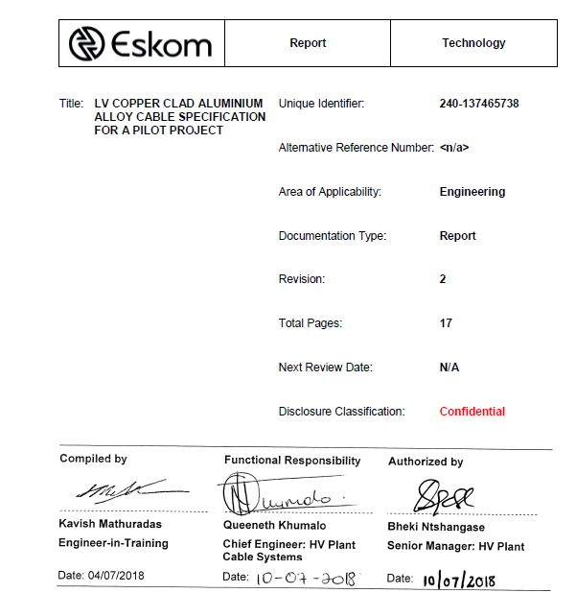
LV CCAA cable specification

Slide 24
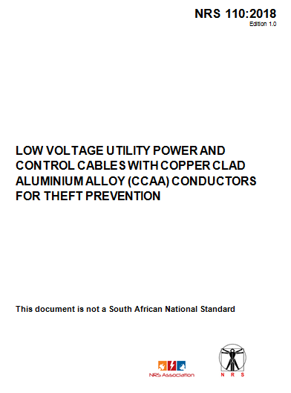
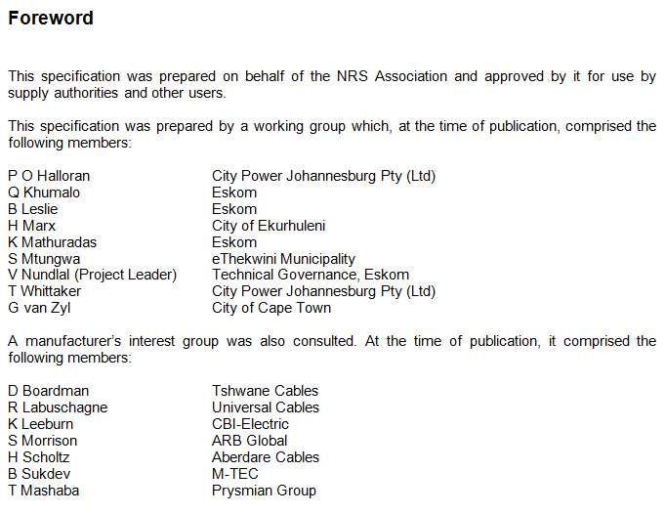
NRS WG report

Slide 25
General remarks
Degrees of responsibility as a candidate engineer
Being exposed, assisting, participating, contributing, performing
Value added to the business:
Participating in projects/tasks:
WG development of CCAA cables to mitigate copper theft
Busbar protection philosophy
Protection scheme refurbishment – systems design document
Value added to me:
Improved networking skills
Taking responsibility
Improved problem solving skills
Software training: DigSilent PowerFactory , PSS/E (outage studies)

Slide 26
Thank You

